Slide 1
XFabric: a Reconfigurable In-Rack Network for Rack-Scale Computers
Sergey Legtchenko, Nicholas Chen, Daniel Cletheroe, Antony Rowstron, Hugh Williams, Xiaohan Zhao

Slide 2

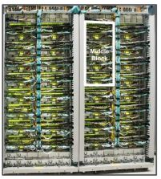
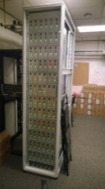

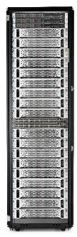
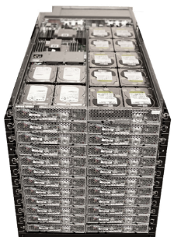
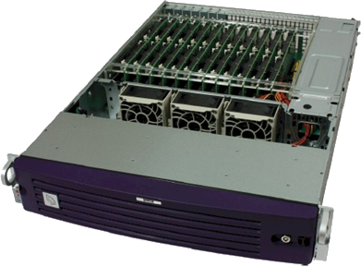

Increasing Performance per $ in Data Centers
Hardware designed for data centers
Google Jupiter
(data center fabric)
Pelican
Cold Storage
Racks as units of deployment & operation
Systems on Chip (SoCs)
Controllers: IO, memory...
CPU
NIC/Packet switch
SoC
d ports
Standard rack
Open CloudServer (OCS) rack
Rack scale computer
40 servers
80 CPUs
80 servers
160 CPUs
e.g. Boston Viridis
Server = Calxeda SoC
900 (wimpy) CPUs
$$$/server
In-rack consolidation
$/server

Slide 3

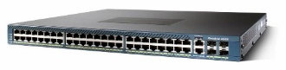

In-rack Networks for Rack-Scale Computers
Challenge: reducing in-rack network cost
900 ports
ToR switch?
Full bisection bandwidth: 9 Tbps
Cost: $$$$$
Rack scale computer
e.g. Boston Viridis
Server = Calxeda SoC
900 (wimpy) CPUs
Multi-tiered?
>900 ports
High power draw/cost
Direct connect topology
(e.g. mesh)
SoCs with packet switches
Low cost
Oversubscribed
d ports/SoC

Slide 4
Oversubscription in Direct-Connect Topologies
Multi-hop routing
Path length impacts performance
Higher, less predictable latency
Lower goodput
SoC A
A->D
SoC B
CPU
Packet
switch
Packet
switch
CPU
…
…
SoC C
SoC D
Example: 3D Torus with 512 SoCs
Average hop count = 6
6x oversubscription
CPU
Packet
switch
Packet
switch
CPU
…
…
Path length is low if the topology is adapted to traffic

Slide 5
XFabric: a Reconfigurable Topology
Adapting topology to traffic
Lower path length
Reduced oversubscription
SoC A
SoC B
CPU
Packet
switch
Packet
switch
CPU
…
…
SoC C
SoC D
CPU
Packet
switch
Packet
switch
CPU
…
…
Rack

Slide 6
XFabric: a Reconfigurable Topology
Physical circuit
Adapting topology to traffic
Lower path length
Reduced oversubscription
SoC A
SoC B
CPU
Packet
switch
Packet
switch
CPU
…
…
Circuit switched fabric
Electrical signal forwarding
No queuing, no packet inspection
SoC C
SoC D
CPU
Packet
switch
Packet
switch
CPU
…
…
Rack

Slide 7
XFabric: a Reconfigurable Topology
Adapting topology to traffic
Lower path length
Reduced oversubscription
SoC A
SoC B
A->D
CPU
Packet
switch
Packet
switch
CPU
…
…
Circuit switched fabric
Electrical signal forwarding
No queuing, no packet inspection
SoC C
SoC D
CPU
Packet
switch
Packet
switch
CPU
…
…
Rack

Slide 8
XFabric: a Reconfigurable Topology
Adapting topology to traffic
Lower path length
Reduced oversubscription
SoC A
SoC B
A->D
CPU
Packet
switch
Packet
switch
CPU
…
…
Circuit switched fabric
Electrical signal forwarding
No queuing, no packet inspection
SoC C
SoC D
CPU
Packet
switch
Packet
switch
CPU
…
…
Rack

Slide 9
XFabric Architecture
Data center aggregation switch
Uplinks
Periodic topology reconfiguration
Dynamic uplink placement
SoC A
SoC B
CPU
Packet
switch
Packet
switch
CPU
…
…
Controller
(process on one SoC in the rack)
Control plane
SoC C
SoC D
Generate topology
Minimize path length
CPU
Packet
switch
Packet
switch
CPU
…
…
Rack
Estimate
demand
Configure data plane
Assign circuits
Update SoC routing

Slide 10
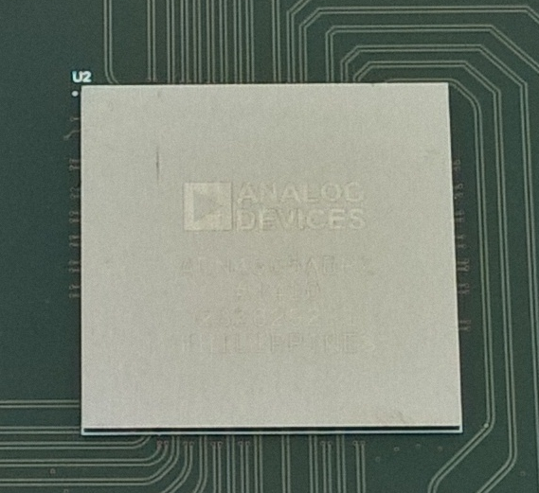
Circuit-Switching Fabric Cost
Commodity ASICs
160 ports @ 10 Gbps
Max size: ~350 ports
SoC A
SoC B
Cost : $3/port
CPU
Packet
switch
Packet
switch
CPU
…
…
Challenge: high port count
Too high port count for one ASIC
SoC C
SoC D
CPU
Packet
switch
Packet
switch
CPU
…
…
Rack
e.g. 300 SoCs, 6 ports/SoC: 1,800 ports

Slide 11
Circuit-Switching Fabric Cost
Commodity ASICs
160 ports @ 10 Gbps
Max size: ~350 ports
SoC A
SoC B
Cost : $3/port
CPU
Packet
switch
Packet
switch
CPU
…
…
Challenge: high port count
Too high port count for one ASIC
Folded Clos total cost: $27K
x30 300 port ASICs
SoC C
SoC D
CPU
Packet
switch
Packet
switch
CPU
…
…
Rack
e.g. 300 SoCs, 6 ports/SoC: 1,800 ports

Slide 12
Reducing Circuit-Switching Fabric Cost
Trading off reconfigurability for cost
Full reconfigurability:
Any 2 ports can be connected
SoC A
SoC B
CPU
Packet
switch
Packet
switch
CPU
…
…
SoC C
SoC D
CPU
Packet
switch
Packet
switch
CPU
…
…
Rack

Slide 13
Reducing Circuit-Switching Fabric Cost
Trading off reconfigurability for cost
Full reconfigurability:
Any 2 ports can be connected
Partial reconfigurability:
Port can connected to subset of ports
SoC A
SoC B
CPU
Packet
switch
Packet
switch
CPU
…
…
SoC C
SoC D
CPU
Packet
switch
Packet
switch
CPU
…
…
Rack

Slide 14
Reducing Circuit-Switching Fabric Cost
Trading off reconfigurability for cost
Full reconfigurability:
Any 2 ports can be connected
Partial reconfigurability:
Port can connected to subset of ports
SoC A
Connected to port 0
on all SoCs
SoC B
CPU
Packet
switch
Packet
switch
CPU
…
…
…
SoC C
SoC D
CPU
Packet
switch
Packet
switch
CPU
…
…
Connected to port N
on all SoCs
Rack

Slide 15
Reducing Circuit-Switching Fabric Cost
Trading off reconfigurability for cost
Full reconfigurability:
Any 2 ports can be connected
Partial reconfigurability:
Port can connected to subset of ports
SoC A
x6 300-port ASICs
SoC B
CPU
Packet
switch
Packet
switch
CPU
…
…
…
SoC C
SoC D
CPU
Packet
switch
Packet
switch
CPU
…
…
Rack
x5 Lower cost compared to full reconfigurability: $5.4K

Slide 16
XFabric Performance at Rack Scale
Flow-based simulation, 343 SoCs, 6 ports/SoC

Slide 17
XFabric Performance at Rack Scale
Flow-based simulation, 343 SoCs, 6 ports/SoC
Varying traffic skew
(7x7x7)
Skewed
Uniform

Slide 18
XFabric Performance at Rack Scale
Flow-based simulation, 343 SoCs, 6 ports/SoC
Varying traffic skew
Production cluster workload
Traffic matrix from TCP flow trace
(7x7x7)
Lower is
better
(7x7x7)
Path length (#hops)
Skewed
Uniform

Slide 19
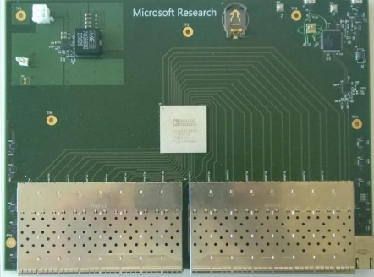
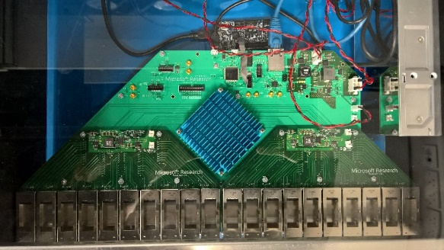
XFabric Prototype Performance
Server
XFabric prototype
SoC emulated by server
Application
Software
Packet Switch
Filter driver
27 servers
Unmodified TCP/IP applications
6 circuit switches, custom PCB design
6 NICs
Gen1: 32 ports @ 1Gbps
Gen2: 160 ports @ 10Gbps

Slide 20
XFabric Prototype Performance
Server
XFabric prototype
SoC emulated by server
27 servers
Unmodified TCP/IP applications
6 circuit switches, custom PCB design
Application
Software
Packet Switch
3DTorus
Filter driver
6 NICs
23% improvement
Completion time
(normalized to 3DTorus)
Gen1: 32 ports @ 1Gbps
Gen2: 160 ports @ 10Gbps
Reconfiguration period (sec)

Slide 21
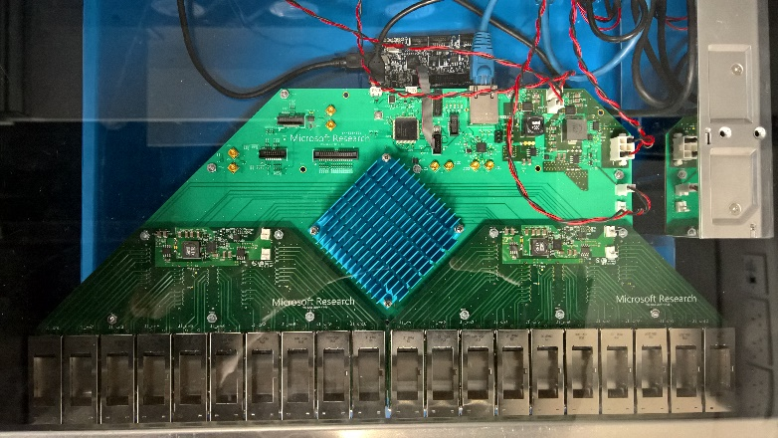
Conclusion
Rack-Scale Computers
Higher performance per $
Up to hundreds of SoCs/rack
XFabric: in-rack network with reconfigurable topology
Dynamic adaptation to traffic demand
Low cost
Deploying new circuit switch hardware
Electrical circuit switching, 160 ports @ 10Gbps

